Slide 1
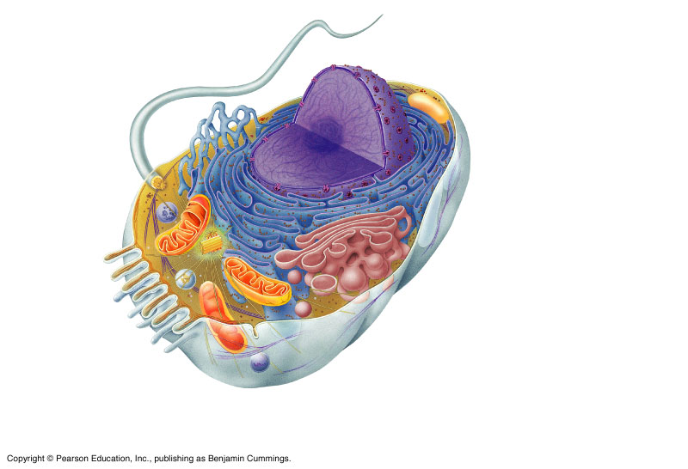
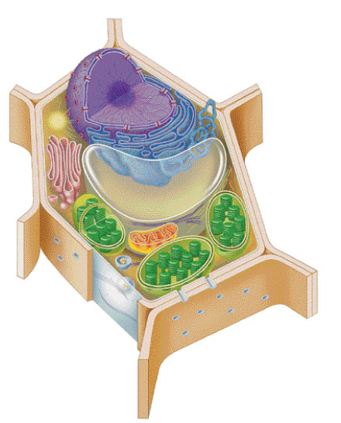
Cells, Cell Organelles
Dr. Rajeev Mukhia

Slide 2
Cell (Robert Hooke-1665)
structural and functional units of all living organisms.
building blocks of the human body.
adult human body contains ~ 75 trillion cells.
Tissue: consists of cells and intercellular substance.
Organ: consists of different tissues which have related function.
System: consists of different organs which have related function.
Cells → Tissues → Organs → System → Bodies

Slide 3
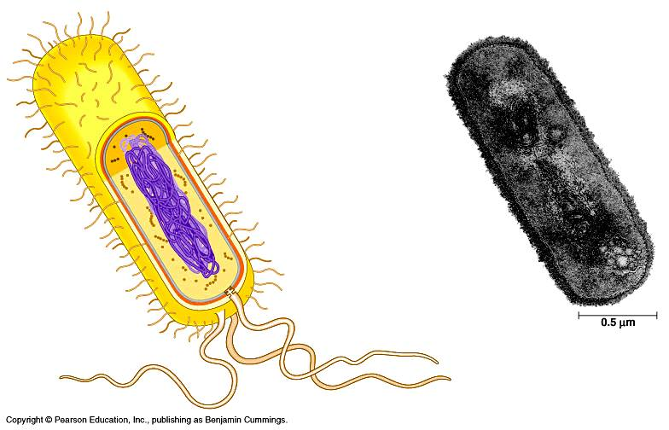
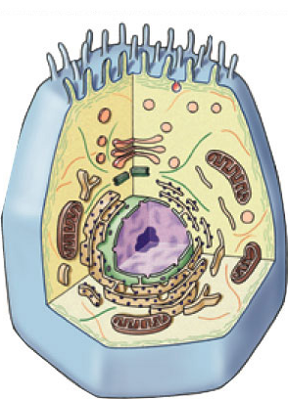
Types of cells
bacteria cells
Prokaryote
- no organelles
Eukaryotes
- organelles
animal cells
plant cells

Slide 4
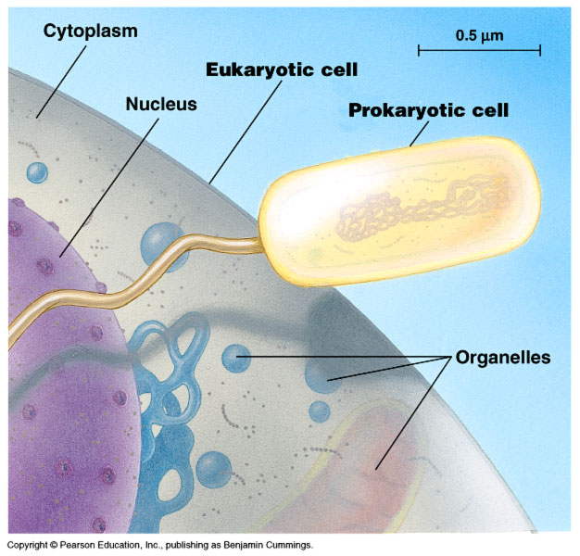
Cell size comparison
Animal cell
most bacteria
1-10 microns
eukaryotic cells
10-100 microns
Bacterial cell
micron = micrometer = 1/1,000,000 meter
diameter of human hair = ~20 microns

Slide 5
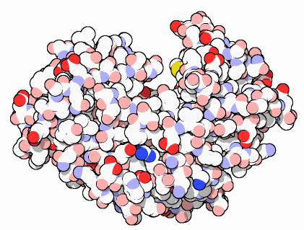
Function of Cells
making energy
need energy for all activities
making proteins
proteins do all the work in a cell, so we need lots of them
ATP

Slide 6
Obtain nutrients and other materials from its surrounding fluids.
Fuel molecules, O_{2,} minerals, etc
Dispose of wastes products
Urea (from nitrogen), CO₂, metabolic waste
Maintain shape and integrity
Size and shape are related to function

Slide 7
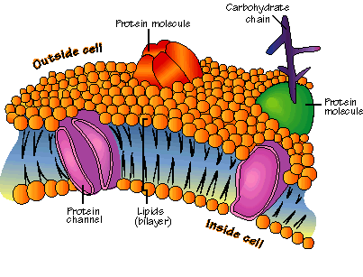
Plasma (Cell) Membrane
Fluid mosaic model – Singer & Nicholson 1972
the outer limiting barrier of the cell.
separates the internal contents of the cell from external materials.
Structure: Double layer of phospholipids with
embedded proteins.
Integral protein:
Provide structural channel for ions.

Slide 8
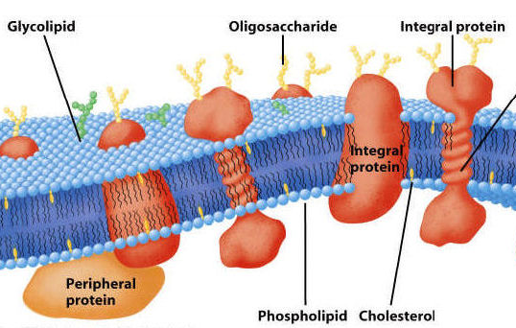
Peripheral protein:
situated inner side.
function as enzymes.
hydrophilic ("water-loving") at their phosphate head and hydrophobic ("water-fearing") along their lipid tail regions.
phosphate “head
lipid “tail”

Slide 9
Function
Separates cell from outside.
Maintain the shape of the cell and provide micro-environment for cell function.
It allows free passage of water and gases like O₂, CO₂ .
Impermeable to water soluble substances like ions, glucose, urea etc.
Recognizes signals from other cells allows communication between cells.
Some of them act as enzymes.

Slide 10
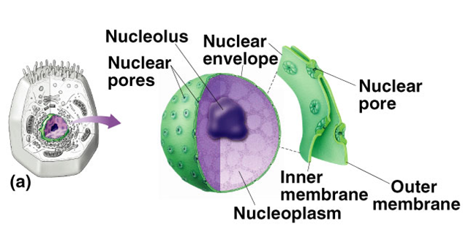
The Nucleus
More or less spherical mass, situated within the cytoplasm near the centre of the cell.
largest structure within the cell contains genetic materials deoxyribonucleic acid (DNA) and proteins (histones)
Control center of cellular activities.
Enclosed by a double membrane called the nuclear membrane.
The nuclear membrane: Contain nuclear pores that allow entry and exit of materials between the nucleus and the cytoplasm.
The Nucleus consist of ;
Nuclear membrane
Nucleolus
Chromosome

Slide 11
Nucleolus:
Highly refractile spherical body without any covering membrane, and situated close to the nuclear membrane.
It is a compressed mass of a mixture of RNA(ribosome) granules & protein.
region of intensive ribosomal RNA synthesis

Slide 12
Chromosome
During cell division the chromatin replicates and becomes more tightly coiled forming chromosomes.
The functional subunits of chromosomes are called genes.
Composed of DNA and protein
Scattered throughout the nucleus

Slide 13
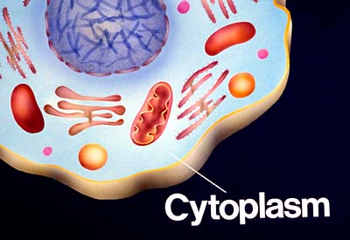
Cytoplasm
It is the part between the cell membrane & the nuclear membrane.
Contain 2-parts;
Organelles/ active elements:
Inclusions/ paraplasms: glycogen, fat globules, pigment.

Slide 14
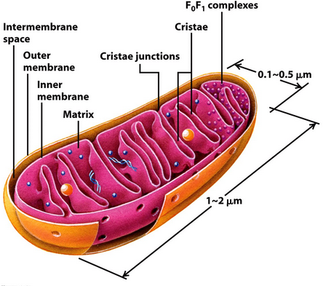
Cytoplasmic Organelles Mitochondria
Sausage shaped organelles
“Powerhouses” of the cell
Made up of double membrane;
outer membrane: lipid synthesis, fatty acid metabolism.
Inner membrane: ATP production.
Inner membrane is folded to form incomplete partitions known as cristae.
More in Liver and muscle cell

Slide 15
Ribosomal granules
Tiny electron dense granules composed of RNA and protein.
Present in nucleolus appears in cytoplasm through nuclear pores.
Are of 2 types;
Free ribosomes: synthesize proteins from amino acids which are utilized for the metabolism of the cell & its own growth.
Attached ribosomes: attached to the ER making their surface rough.

Slide 16
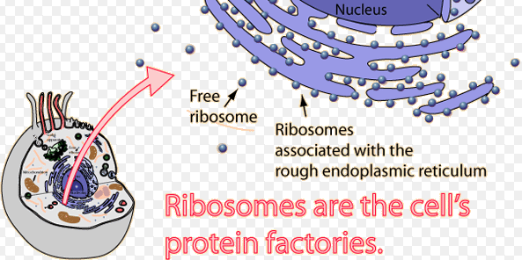
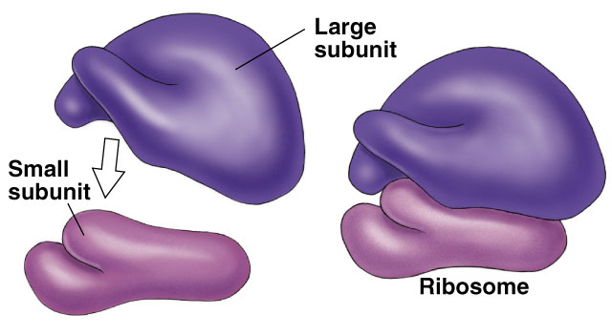

Slide 17
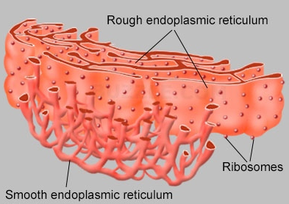
Endoplasmic reticulum(ER)
It is a series of interconnecting membranous tubules/canals, which may extend from the nuclear membrane to the cell membrane.
Two types;
Rough Endoplasmic reticulum(rER):
Ribosome granules are attached to its surface.
Helps in protein synthesis & its storage.
Smooth Endoplasmic reticulum(sER):
No attached ribosomes
help in the synthesis of lipid, glycogen
and steroid hormones.
Also associated with the detoxification of drugs.

Slide 18
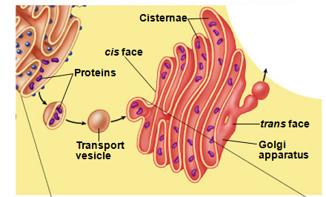
Golgi apparatus
The Golgi apparatus consists of a stack of curved/folded saccules.
It receives protein and lipid-filled vesicles from the ER, processes, packages, and distributes them within the cell.

Slide 19
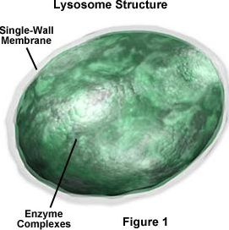
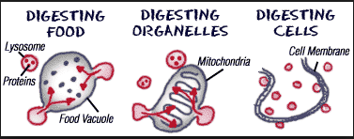
Lysosomes
They are thick-walled membrane bound vesicles which contain hydrolytic enzymes, namely lipases, proteases & acid phosphatase.
Mostly seen in macrophages, neutrophlilic leukocyte.
Function
Digestion of waste and harmful materials that enter cell by endocytosis.
Remove worn-out or damaged organelles & cellular component.
Self destruction: digest the remains(autolysis) after cellular death, suicidal bags of the cell.

Slide 20
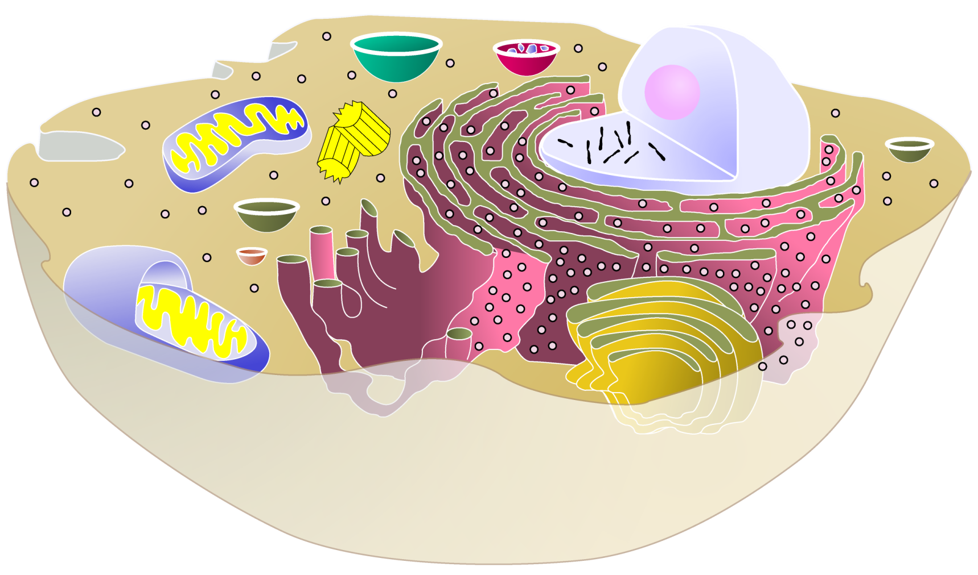
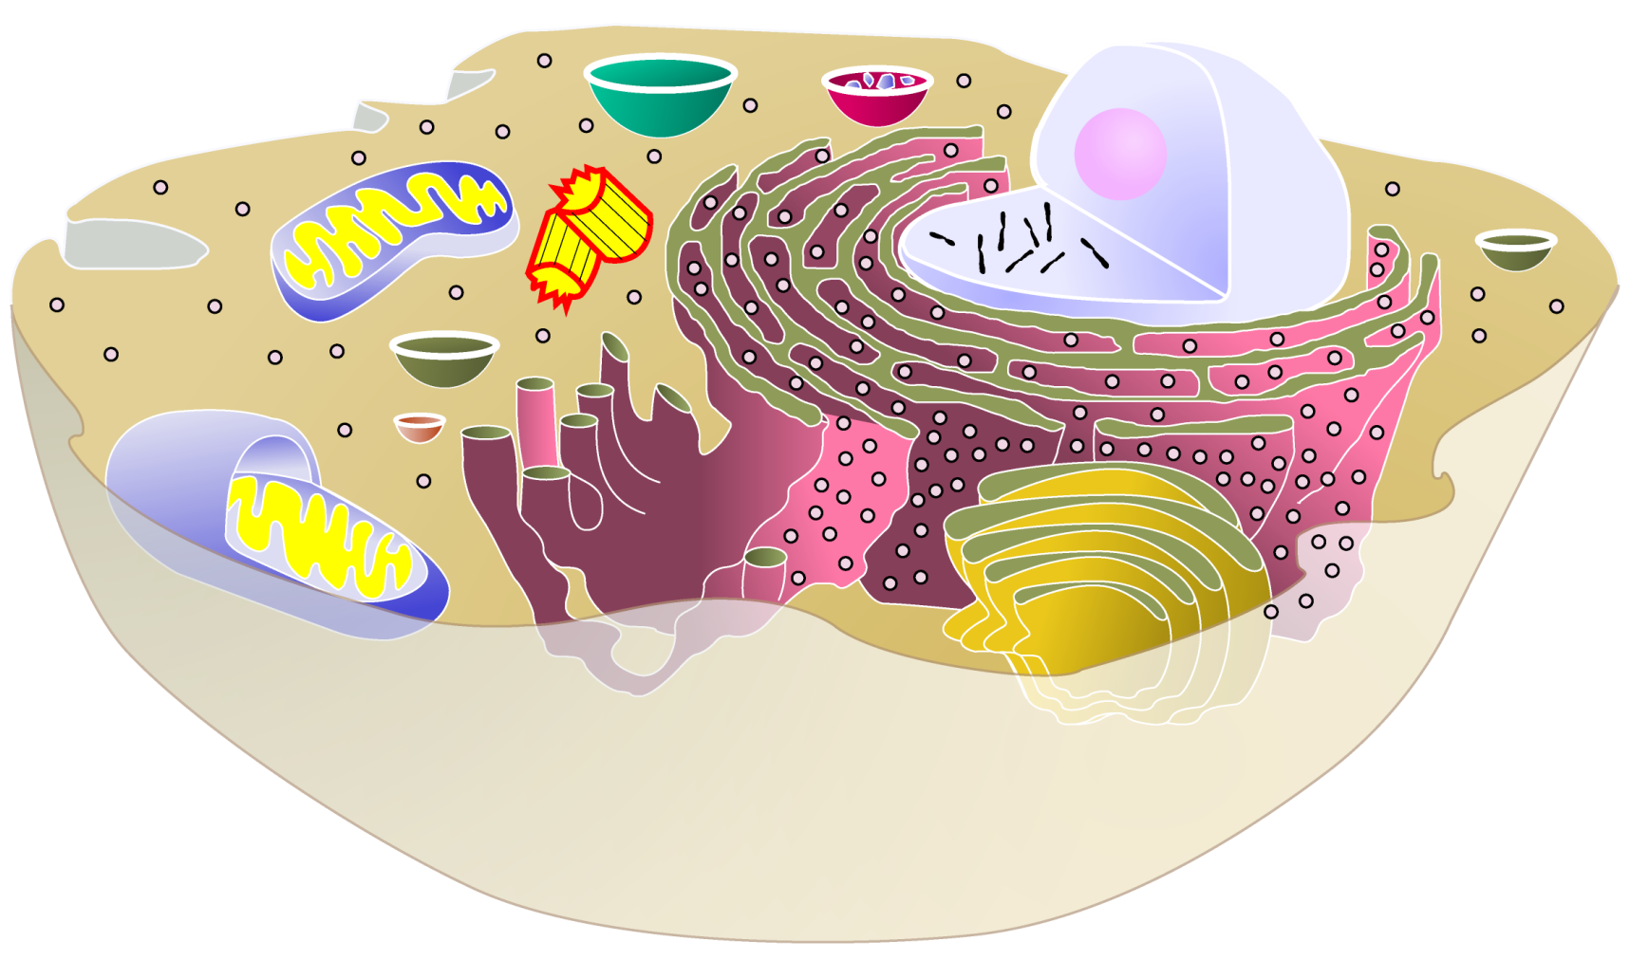
Summary
lysosome
▪food digestion
▪garbage disposal & recycling
cytoplasm
▪jelly-like material holding organelles in place
nucleus
▪protects DNA
▪controls cell
centrioles
▪cell division
ribosomes
▪builds proteins
mitochondria
▪make ATP energy from sugar + O₂
Golgi apparatus
▪finishes, packages & ships proteins
cell membrane
▪cell boundary
▪controls movement of materials in & out
▪recognizes signals
ER
▪helps finish proteins
▪makes membranes

Slide 21

That’s all my cellular story…

